Slide 1
Image segmentation by Grover Algorithm
Team: Voyager
Members: Hoyeon Kook, dasan kim, huihun kim, bumkyu park, byoungoh hwang
Mentor: saesun kim

Slide 2
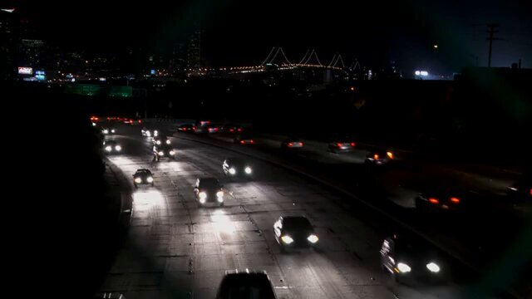
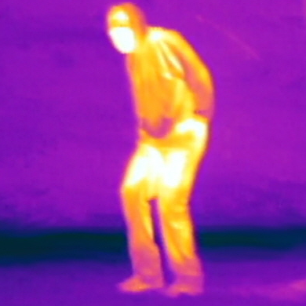

About the project
A fast target detection method (car’s headlights, infrared camera, etc…)

Slide 3
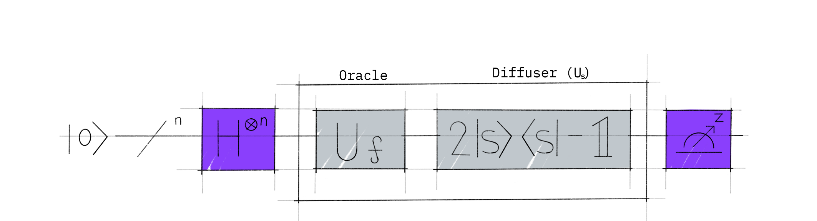
What is Grover’s Algorithm?
H Gate:
Superpositioning the qubits
Oracle:
Checking the answers
Diffuser:
Amplifying the probabilities
Picture Source: https://qiskit.org/textbook/ch-algorithms/grover.html
Paper Source: Lov K. Grover, 「A fast quantum mechanical algorithm for database search」, 19 Nov 1996

Slide 4

Why did we use Grover Algorithm?
Saving times effectively
0
1
0
1
N times
$\sqrt{N}$ times!!
Answer received
Answer received
<Normal Algorithm>
<Grover Algorithm>

Slide 5
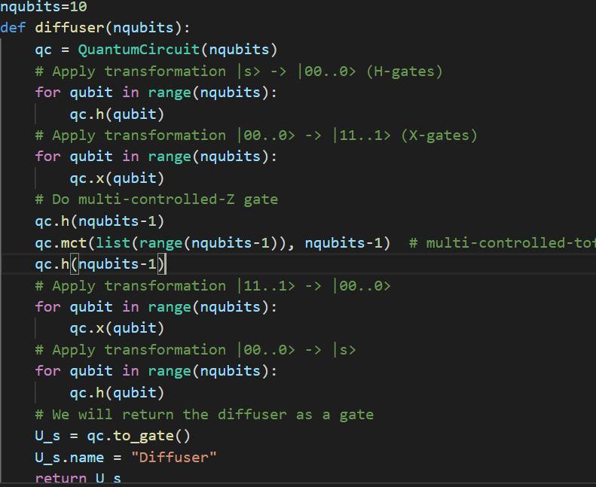
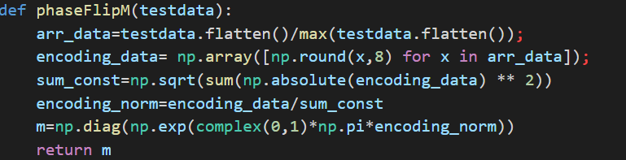
Example of codes

Slide 6
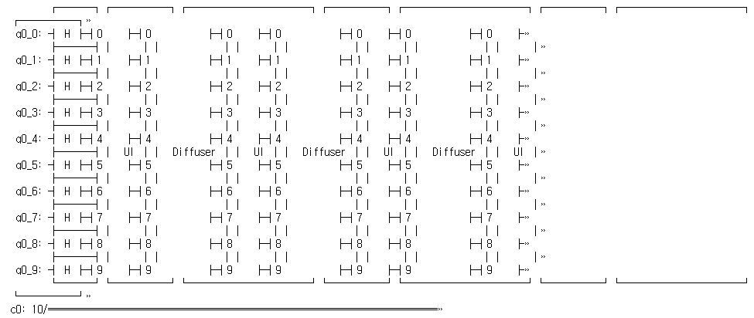
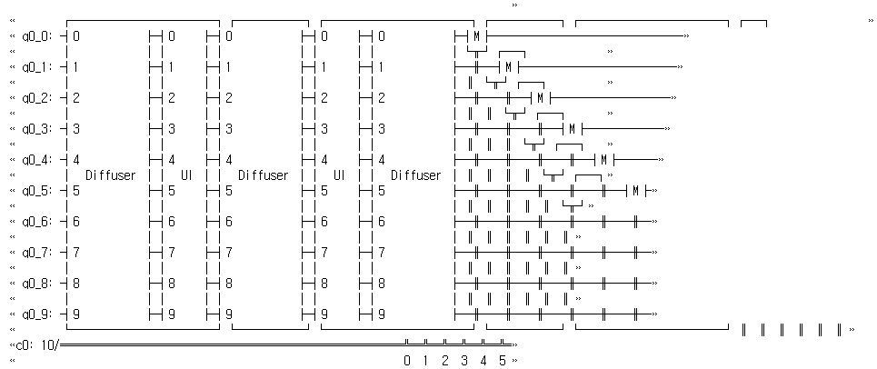
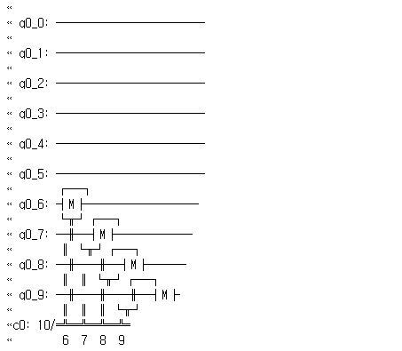
Example of codes

Slide 7
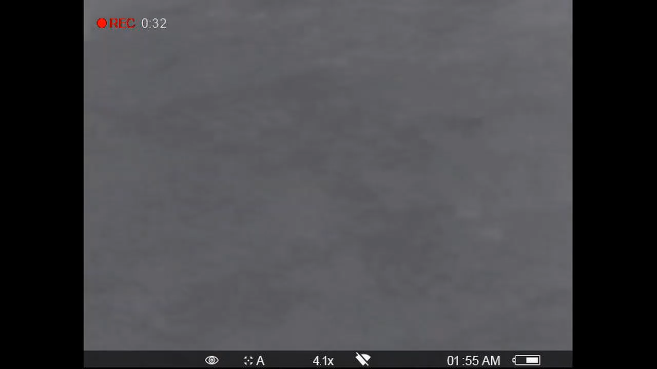

Slide 8
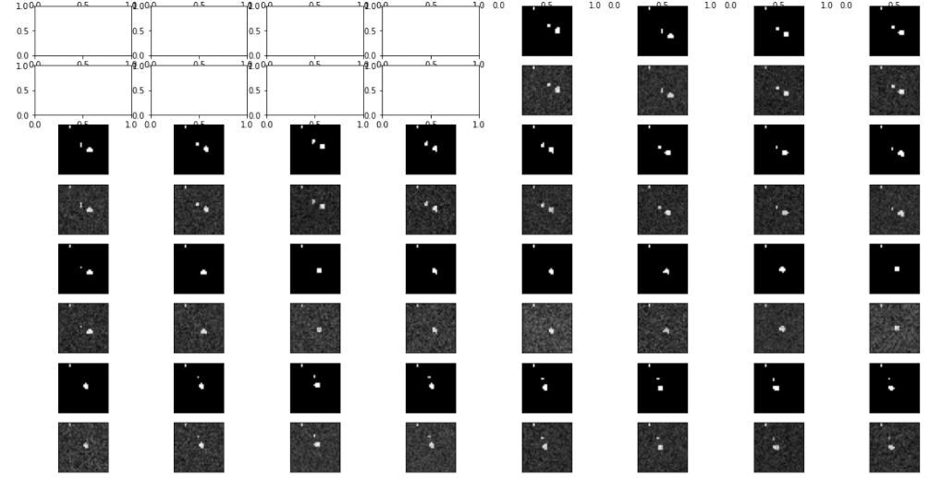
Results

Slide 9
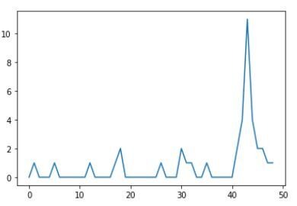
Results

Slide 10
Conclusion
Grover Algorithm detects rapid image changes
This image segmentation would be better when qubits’ performance are improved

Slide 11
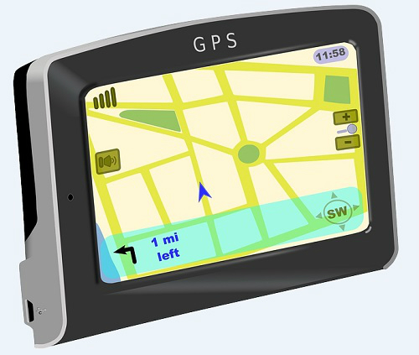


Further Study
Traffic volume
Measure the traffic volume for navigation
Tracking criminals using car
Infrared camera
Applying it to quarantine system
Security part such as detecting strangers
Using it in satellite to detect the certain phenomenon on Earth
Environmental problems like forest fire
National security such as detecting a missile

Slide 12
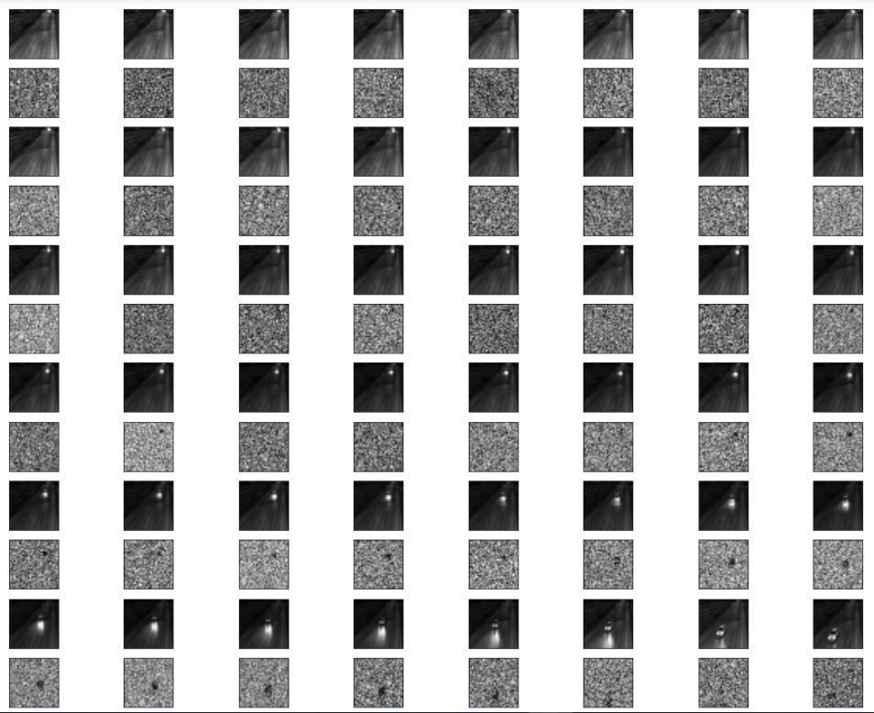
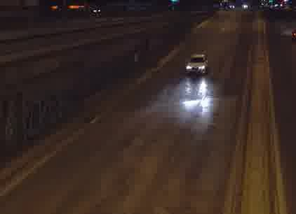
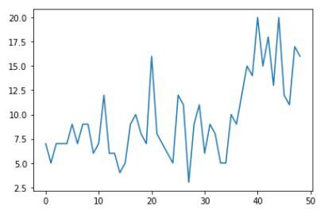
Another Results

Slide 13
